Slide 1

What is Microsoft Power BI?

Slide 2
Key Objectives
1
2
To Show some key popular scenarios where Power BI can find Applications
To create a clear Understanding of What Microsoft Power BI Is

Slide 3
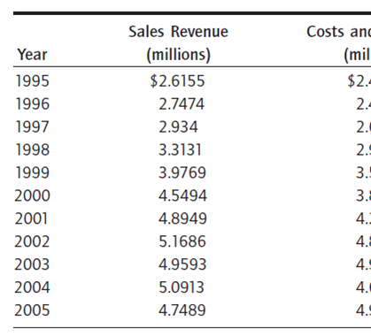
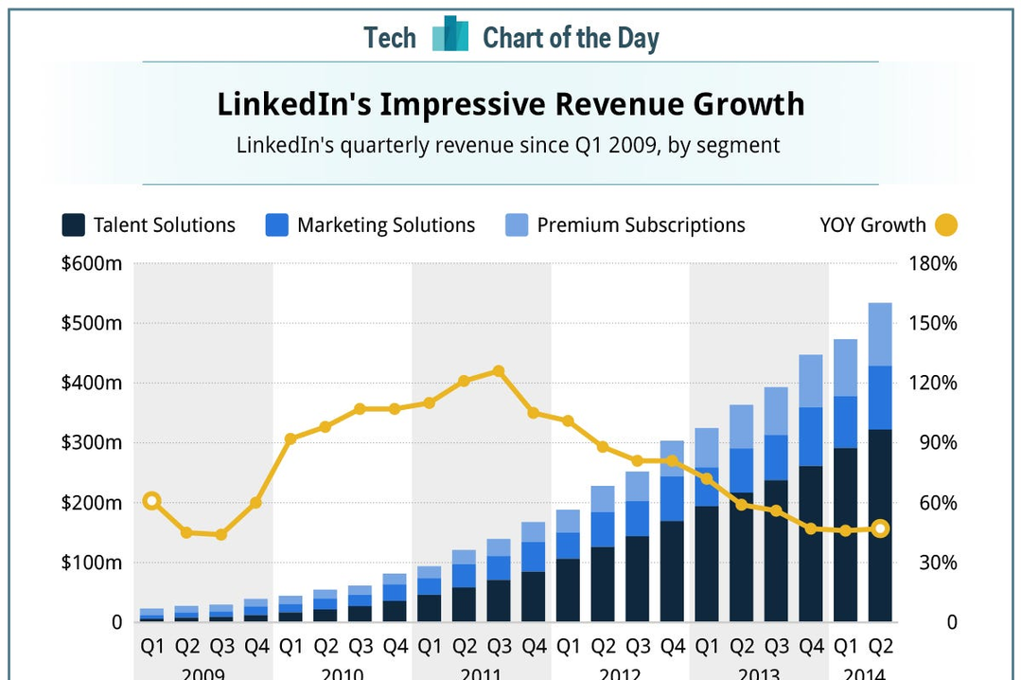
In simple Terms, Power BI is a tool that can convert a table of data into charts like this which sponsors decision Making

Slide 4

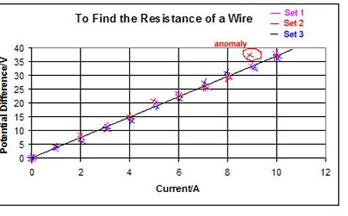
It all started like this, where most of the plotting was done manually, but now the narrative has taken another dimension

Slide 5
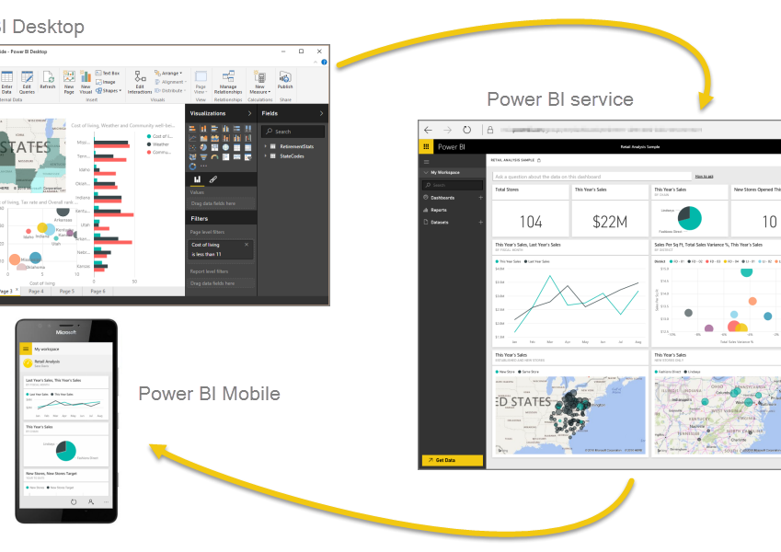
The different parts of power BI that works together to give the unique feel that Microsoft offers are Power BI desktop, Service, and Mobile

Slide 6
Key Functions of the Components of Microsoft Power BI
Desktop
Service
Mobile
1
2
3
This can be referred to as the "kitchen" out of the suite of components where reports are prepared before they are published. It is highly optimized for data preparation, modelling, analysis and reporting​
This is the part of Power BI that is highly optimized for collaboration and sharing of the cooked reports in the desktop. Though reports can still be developed here, it is still not fully developed.​
This brings convenience to the table by creating an avenue through which reports can be consumed without having to access your laptop​

Slide 7
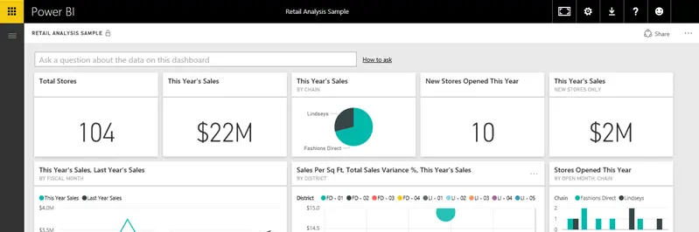
Building Blocks of Microsoft Power BI
Everything done in Power BI is broken down to either of these five basic building blocks viz: Visualizations, Dataset, Report, Dashboard and tiles
Visualizations:
Sometimes it is also referred to as visuals. It is a visual representation of data, like a chart, a color-coded map, or other interesting things you can create to represent your data visually

Slide 8
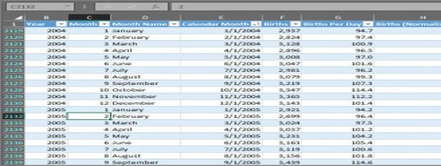
Building Blocks of Microsoft Power BI
Datasets(Query):
This is a collection of data that Power BI uses to create its visualizations.​

Slide 9
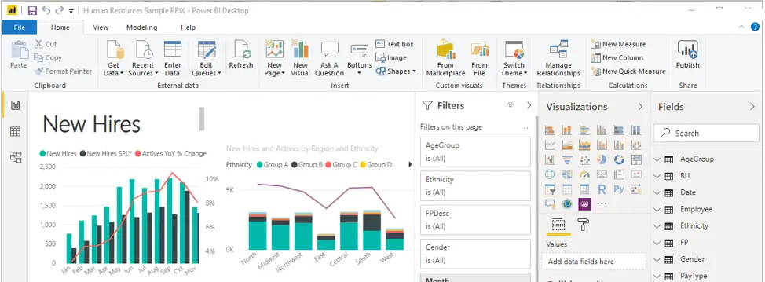
Building Blocks of Microsoft Power BI
Reports​:
In Power BI, a report is a collection of visualizations that appear together on one or more pages.​

Slide 10
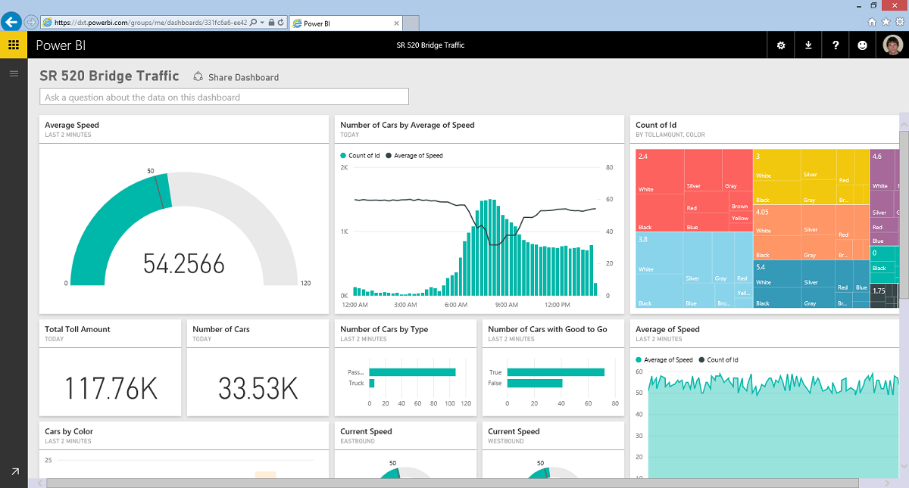
Building Blocks of Microsoft Power BI
Dashboards​​
A Dashboard is an element created in Power BI service. It's a collection of different visuals which can be from different Published reports.

Slide 11
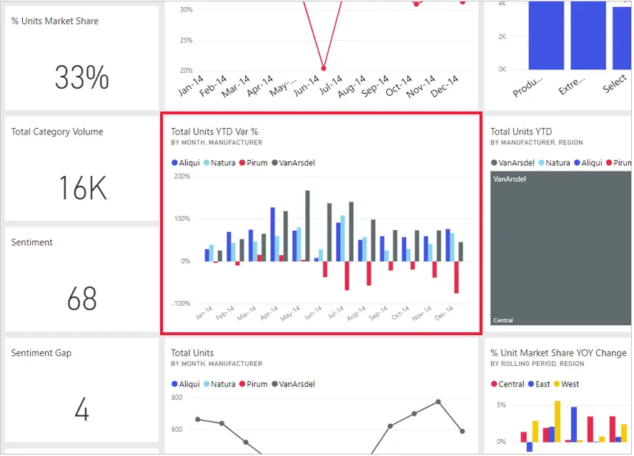
Building Blocks of Microsoft Power BI
Tiles
Is a single visualization on the dashboard represented as a Tile.

Slide 12
Some Use Cases of Microsoft Power BI
Analyzing the sales data for a firm or organization to reveal insights like Total Revenue, Expenses and Key Influencers of your revenue.
Human Resources data analysis to check out for things like attrition, Worker's punctuality and other key metrics that can facilitate quality decisions in a firm.
Also, the health institution keeps huge data of their patients, these data can be pulled into Power BI to create visuals which carries a more cohesive information which can be beneficial in making decisions.
Also, In the educational sector, students and staff data will be better analyzed to glean insight. An awesome solution is building a system that can process the results of students immediately grades are uploaded.

Slide 13

Thanks For your Rapt Attention

